Slide 1
E-Business Strategy and Development
Part-1

Slide 2
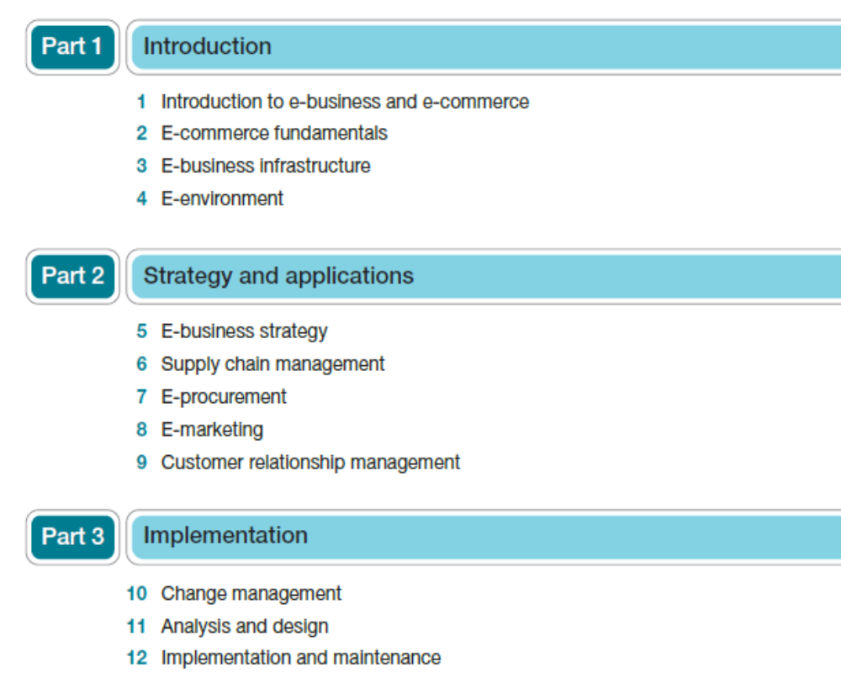
Organised by Dr.Vittapu

Slide 3
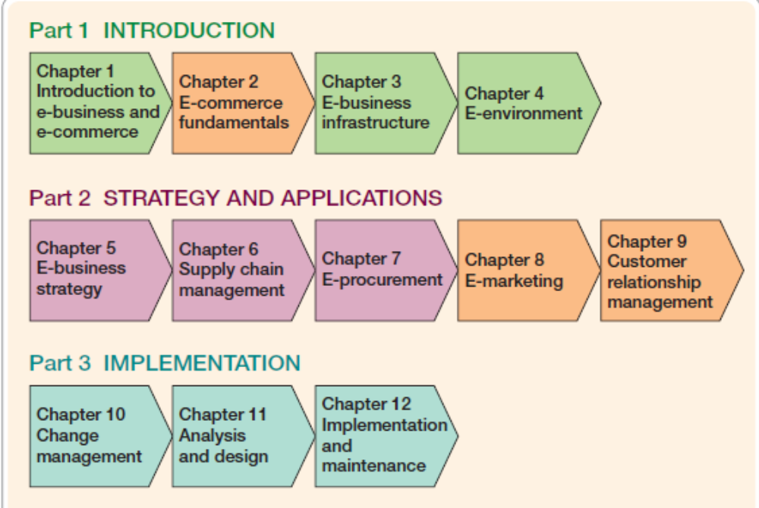
Organised by Dr.Vittapu

Slide 4
Chapter-1
Introduction to E-business and E-commerce
The impacts of the electronic communications on Traditional businesses
What is the difference between e-commerce and e-business.
E-business opportunities
Business adoption of digital technologies for ecommerce and e-business
E-business risks and barriers to business adoption
Management response to E-commerce and E-Business.
Organised by Dr.Vittapu

Slide 5
INTRODUCTION
Organizations have been now applying technologies based on the Internet, WWW and wireless communications to transform their businesses over 5 years since the creation of the first website in 1991.
The Internet ‘The Internet’ refers to the physical network that links computers across the globe. It consists of the infrastructure of network servers and communication links between them that are used to hold and transport information between the client PCs and web servers.
World Wide Web (WWW) The most common technique for publishing information on the Internet. It is accessed through web browsers which display web pages of embedded graphics and HTML/XML-encoded text.
Wireless communications Electronic transactions and communications conducted using mobile devices such as laptops, personal digital assistants (PDAs) and mobile phones (and fixed access platforms) with different forms of wireless connection.
Organised by Dr.Vittapu

Slide 6
The Impacts of the electronic communications on
Traditional business
Social Network
A site that facilitates peer to peer communication within a group or between
Individuals through providing facilities to develop user generated content (UGC) and to Exchange messages and comments between different users.
Virtual Worlds
An electronic environment which simulates interactions between Online characters known as avatars. Also known as massively multiplier Online role-player games (MMORPG)
Blog
Personal online diary. Journal or news source Compiled by one person, an internal team or external guest authors. Postings are usually in different categories. Typically comments can be added to each blog posting to help Create interactively and feed back
Rich Media Digital Assets such as ads are not static images, but provide animation, audio Or interactivity as a game or form to be completed.
Mobile Commerce(M-Commerce)
Electronic transactions and communications conducted using Mobile devices such as laptops, PDAs and mobile phones and typically With a wireless connection.
Organised by Dr.Vittapu

Slide 7
Electronic business (e-business)
Electronic business (e-business) can be defined as the use of the internet to network and empower business processes, electronic commerce, organizational communication and collaboration within a company and with its customers, suppliers, and other stakeholders.
E-businesses utilize the internet, intranets, extranets and other networks to support their commercial processes.
electronic business (e-business) is aimed at enhancing the competitiveness of an organization by deploying innovative information and communications technology throughout an organization and beyond, through links to partners and customers.
It does not simply involve using technology to automate existing processes, but should also achieve process transformation by applying technology to help change these processes.
To be successful in managing e-business, a breadth of knowledge is needed of different business processes and activities from across the value chain such as marketing and sales, through new product development, manufacturing and inbound and outbound logistics.
Organizations also need to manage the change required by new processes and technology through what have traditionally been support activities such as human resources management.
Organised by Dr.Vittapu

Slide 8
Electronic commerce (e-commerce)
Electronic commerce (e-commerce) is the buying and selling, marketing and servicing of products and services via computer networks.
Since e-business includes the process of transacting with suppliers and customers there is an overlap in activities with e-commerce.
The terms ‘e-business’ and ‘e-commerce’ are often used synonymously, the distinction between them lies in the broader range of processes in e-business that incorporates internal transactions within an organization.
These include transactions relating to procurement, logistics, supply chain management, payments, stock control and order tracking.
e-commerce can best be conceived as a subset of e-business.
Where the two concepts overlap is in the buying and selling of products and services.
Organised by Dr.Vittapu

Slide 9
E-Commerce
Electronic commerce (e-commerce) All electronically mediated information exchanges between an organization and its external stakeholders.
1 A communications perspective – the delivery of information, products or services or payment by electronic means.
2 A business process perspective – the application of technology towards the automation of business transactions and workflows.
3 A service perspective – enabling cost cutting at the same time as increasing the speed and quality of service delivery.
4 An online perspective – the buying and selling of products and information online.
E-commerce is the exchange of information across electronic networks, at any stage in the supply chain, whether within an organization, between businesses, between businesses and consumers, or between the public and private sector, whether paid or unpaid
Organised by Dr.Vittapu

Slide 10
E-Commerce Cont…
Buy-side e-commerce transactions between a purchasing organization and its suppliers.
Buy-side e-commerce refers to transactions to procure resources needed by an organization from its suppliers.
Shell has developed an e-business capability that enables buy-side e-commerce for its customers.
Sell-side e-commerce refers to transactions involved with selling products to an organization’s customers.
So e-commerce transactions between organizations can be considered from two perspectives:
sell-side from the perspective of the selling organization and
buy-side from the perspective of the buying organization.
All .org- E-commerce
Organised by Dr.Vittapu

Slide 11
Electronic business (e-business)
Electronic business (e-business) All electronically mediated information exchanges, both within an organization and with external stakeholders supporting the range of business processes.
e-business – the transformation of key business processes through the use of Internet technologies.
The term ‘e-business’ is used in two main ways within organizations
The first is as a concept which can be applied to strategy and operations.
For example, ‘our organization needs an improved e-business strategy (or e-business technology)’.
Secondly, ‘e-business’ is used as an adjective to describe businesses that mainly operate online,
IBM (www.ibm.com/e-business), which was one of the first suppliers to use the term in 1997 to promote its services.
Amazon (www.amazon.com) and eBay (www.ebay.com, Case Study 1.3) are the world’s two biggest e-businesses. All.Com – E-business
Organised by Dr.Vittapu

Slide 12
Information and communication technology (ICT or IT)
Information and communication technology (ICT or IT) The software applications, computer hardware and networks used to create e-business systems.
when a business has fully integrated information and communications technologies (ICTs) into its operations, potentially redesigning its business processes around ICT or completely reinventing its business model . . .
e-business, is understood to be the integration of all these activities with the internal processes of a business through ICT.
Intranet A private network within a single company using Internet standards to enable employees to access and share information using web publishing technology.
Extranet A service provided through Internet and web technology delivered by extending an intranet beyond a company to customers, suppliers and collaborators.
Organised by Dr.Vittapu

Slide 13
The relationship between e-business and e-commerce
E-business
Buying and selling electronically
Electronic procurement
Electronic distribution
Online customer service
Electronic marketing
Secure transactions
Automation of processes
Electronic collaboration
E-commerce
Sell-side e-commerce
Buy-side e-commerce
Buy-side e-commerce refers to electronic transactions between a purchasing organization and its suppliers and sell-side e-commerce refers to electronic transactions between a supplier organization and its customers.
Organised by Dr.Vittapu

Slide 14
The development of the new economy
‘The internet economy’, ‘the information economy’ or ‘the digital economy’.
The distinct contributions to the economy through use of the internet, digital technology, or information and communications technology (ICT).
Together these types of technologies have created the so-called ‘new economy’, one that is based on entrepreneurship in knowledge creation and sharing, innovation and creativity, and utilizing information technology for developing and selling new products and services.
The new economy defined the industrial landscape of the late twentieth century and will be the dominant driver of economies well into the new millennium.
The new economy has been boosted by the development of the infrastructure that supports the internet, ICT and digital technology.
The rollout of high-speed broadband internet access means more people can connect to the internet at higher speed and with greater flexibility and scope of activities.
Digital exchanges and fiber-optic networks mean that the convergence of technologies further boosts the new economy.
Where once the internet, television broadcasting and telecommunications were separate and distinct industries, convergence means that these sectors have increasingly merged, thereby offering consumers greater scope for accessing services via one technology.
Organised by Dr.Vittapu

Slide 15
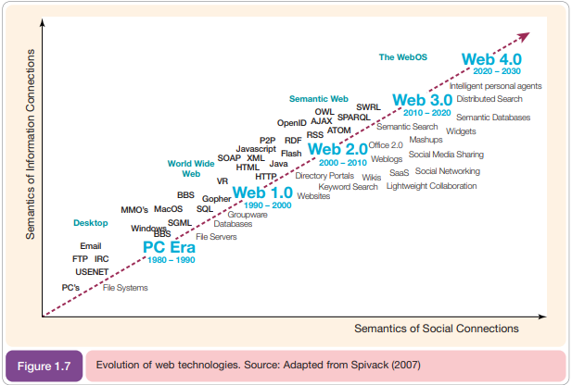
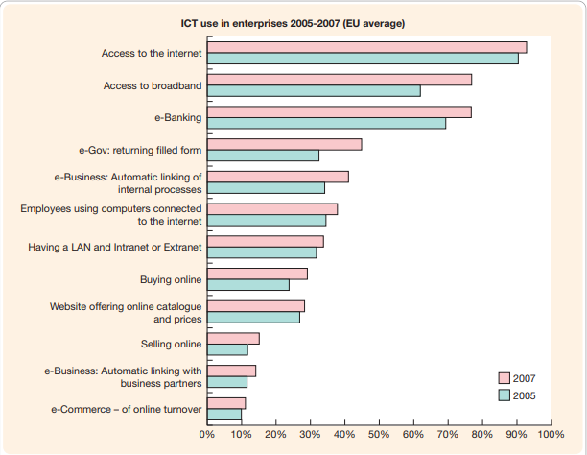
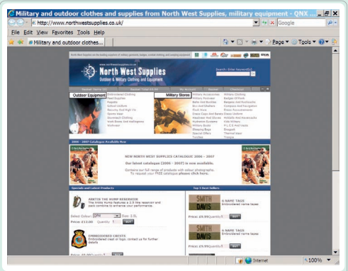
Internet , ICT or Digital economy
Organised by Dr.Vittapu

Slide 16
Development of Internet/extranet/intranet economy :
The new economy is boosted by the development of internet access on mobile phones because it means knowledge workers can access information and communicate with others from almost any location.
The convergence of the internet and television means that interactive television provides an additional media for facilitating online sales of products and services.
Example: Transactional e-commerce sites.
These enable purchase of products online.
The main business contribution of the site is through sale of these products.
The sites also support the business by providing information for consumers that prefer to purchase products offline.
These include retail sites, travel sites and online banking services.
Organised by Dr.Vittapu

Slide 17
Development of ICT economy or digital economy :
A key role in knowledge sharing, encouraging innovation and creativity, integrating global supply chains, facilitating global trade and creating wealth.
Enabled new forms of management and control, both within organizations and between organizations.
Competitive advantage was gained through decreasing production costs or increasing productivity
Example:
Services-oriented relationship-building web sites (Offline and Online website, newsletters)
Brand-building sites(Fast moving consumer goods(FMCG))
Portal, publisherormediasites
Example Digital marketing involves:
Applying these technologies which form online channels to market:
– Web, e-mail, databases, plus mobile/wireless and digital TV.
To achieve these objectives: – Support marketing activities aimed at achieving profitable acquisition and retention of customers … within a multi-channel buying process and customer lifecycle.
Organised by Dr.Vittapu

Slide 18
After Introducing these three technologies with new economy development has globally benefited. The main Benefits are
1 Improved information sharing (customer service), 97%
2 Enhanced communications and information sharing (communications), 95%
3 Increased consistency of information (customer service), 94%
4 Increased accuracy of information (customer service), 93%
5 Reduced or eliminated processing, 93%
6 Easier organizational publishing, 92%.
Organised by Dr.Vittapu

Slide 19
Key differences between the old and new economy
Issues Old economy New economy
Economy factors
Markets Stable Dynamic and complex
Competition National International and global
Structure Manufacturing Service
Value driver Physical Human capital
Business factors
Organization Hierarchy Network or virtual
Production Mass Flexible, customized
Growth driver Capital and labor Innovation and knowledge
Technology driver Machines Digital and electronic
Competitive advantage Low cost/High production Innovation/speed and quality
Relationships Independent Collaborative
Consumer factors
Tastes Stable Dynamic, segmented
Skills Specialized Multiple and flexible
Educational needs Trade orientated Lifelong learning
Workplace relations Confrontational Collaborative
Nature of employment Stable Insecure, opportunistic
Organised by Dr.Vittapu

Slide 20
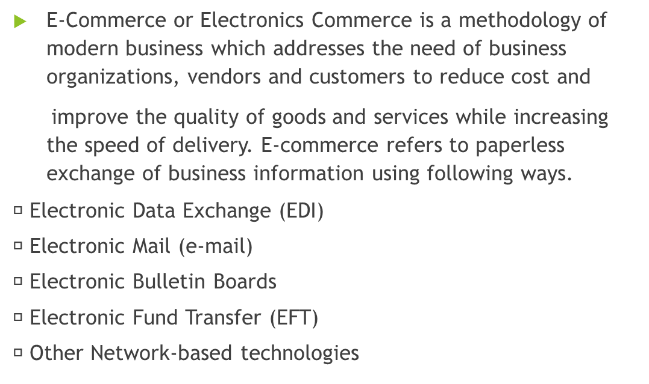
Types of e-business and related industries
Organised by Dr.Vittapu

Slide 21
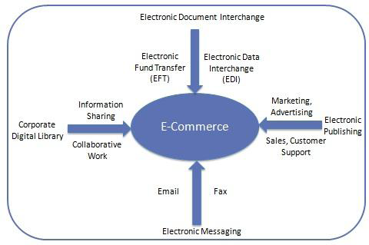
E-Commerce
Organised by Dr.Vittapu

Slide 22
E-business opportunities
E-government The application of e-commerce technologies to government and public services for citizens and businesses.
E-government refers to the application of e-commerce technologies to government and public services. In the same way that e-business can be understood as transactions with cus_x0002_tomers (citizens), suppliers and internal communications, e-government covers a similar range of applications:
Citizens – facilities for dissemination of information and use of online services at local and national levels. For example, at a local level you can find out when refuse is collected and at national level it is possible to fill in tax returns.
Suppliers – government departments have a vast network of suppliers. The potential benefits (and pitfalls) of electronic supply chain management and e-procurement described in Chapters 6 and 7 are equally valid for government.
Internal communications – this includes information collection and dissemination and e-mail and workflow systems for improving efficiency within government departments
Organised by Dr.Vittapu

Slide 23
E-business opportunities Cont.…
E-business has introduced new opportunities for small and large organizations to compete in the global marketplace. Many commentators have noted that one of the biggest changes introduced by electronic communications is how approaches to transmitting and transforming information can be used for competitive advantage.
A significant commentary on the disruptive, transformational nature of electronic communications is provided in Box 1.2.
1.Reach. Conventionally, ‘reach’ refers to the potential number of customers a business can interact with. The Internet enables reach to be increased nationally and internationally at low cost through making content available via search engines. ‘Reach’ also refers to the number of different categories and products a consumer interface (e.g. store, catalogue or web site) can cover: witness the large range of products available through e-businesses such as Amazon, eBay and Kelkoo.com and existing companies such as easyJet.com and Tesco.com which have used the web to extend their product range.
2 Richness. This is a characteristic of the information itself. The Internet enables more detailed information about products, prices and availability to be made available. It also enables more interactivity and customization to engage customers and to provide more up-to-date information. But, Evans and Wurster also note that richness is limited by bandwidth (the volume of information that can be transmitted using a communications link in a given time), the accuracy or reliability of information and its security.
3 Affiliation. This refers to the effectiveness of links with partners. In an online context, an organization which has the most and richest links with other compatible organizations will be able to gain a larger reach and influence. Consider how e-businesses such as eBay, Google and Yahoo! have successfully formed partnerships or acquired other companies to provide new diverse information services such as social networking, mapping, voice communications and online photography, to name just a few
In markets such as car sales which have been transformed by the Internet, understanding how to improve reach, richness and affiliation is crucial. This is not because a large proportion of people buy cars online, but rather the majority research online their preferred make, model and supplier.
Organised by Dr.Vittapu

Slide 24
E-business opportunities Cont.…
The Internet also provides significant opportunities for many businesses to build closer relationships with their existing customers and suppliers online to help achieve customer retention.
Encouraging use of online, e-business services by customers and suppliers can significantly reduce costs while providing a new, convenient channel for purchase and customer service.
Soft lock-in Customers or suppliers continue to use online services because of the switching costs.
Through providing high-quality online services, organizations can build lasting relationships with their stakeholders. While it is sometimes said that ‘online, your customers are only a mouse click away from your competitors’, this is a simplification, and encouraging use of online services can help achieve ‘soft lock-in’.
This means that a customer or supplier continues to use a service since they find the service valuable and they have also invested a lot of time in learning the service or integrating it with their systems and there are some costs in switching.
Think of different online services you use for different purposes. How often do you switch between them? Of course, the ideal is that the service meets the needs of its users so well and delivers value such that they are satisfied and do not consider switching.
Organised by Dr.Vittapu

Slide 25
Business adoption of digital technologies for e-commerce and e-business
As managers, we need to assess the impact of e-commerce and e-business on our marketplace and organizations.
What are the drivers of changed consumer and business behavior?
How should we respond?
How much do we need to invest?
What are our priorities and how quickly do we need to act?
Answering these questions is an essential part of formulating an e-business
e-marketing strategy.
Drivers of business Internet adoption
Organised by Dr.Vittapu

Slide 26
Business adoption of digital technologies for e-commerce and e-business
Business adoption of e-commerce and e-business is driven by benefits to different parts of their organization.
First and foremost, they are concerned how the benefits of e-business will impact on profitability or generating value to an organization.
The two main ways in which this can be achieved are:
Potential for increased revenue arising from increased reach to a larger customer base and encouraging loyalty and repeat purchases among existing customers.
Cost reduction achieved through delivering services electronically. Reductions include staff costs, transport costs and costs of materials such as paper.
Organised by Dr.Vittapu

Slide 27
Business adoption of digital technologies for e-commerce and e-business
Cost/efficiency drivers
1 Increasing speed with which supplies can be obtained
2 Increasing speed with which goods can be dispatched
3 Reduced sales and purchasing costs
4 Reduced operating costs.
Competitiveness drivers
5 Customer demand
6 Improving the range and quality of services offered
7 Avoiding losing market share to businesses already using e-commerce.
Organised by Dr.Vitta
pu

Slide 28
Business adoption of digital technologies for e-commerce and e-business Cont…
More recently, in interviews with Australian businesses, Perrott (2005) identifies
four key areas driving performance which are
  cost–benefit,
  competitive pressures,
  market advantage and
  value adding, i.e. improving customer satisfaction while building strong relationships.
When reviewing potential benefits, it is useful to identify both tangible benefits (for which monetary savings or revenues can be identified) and intangible benefits (for which it is more difficult to calculate cost savings). The types of potential benefits are summarized in Table 1.3
Organised by Dr.Vittapu

Slide 29
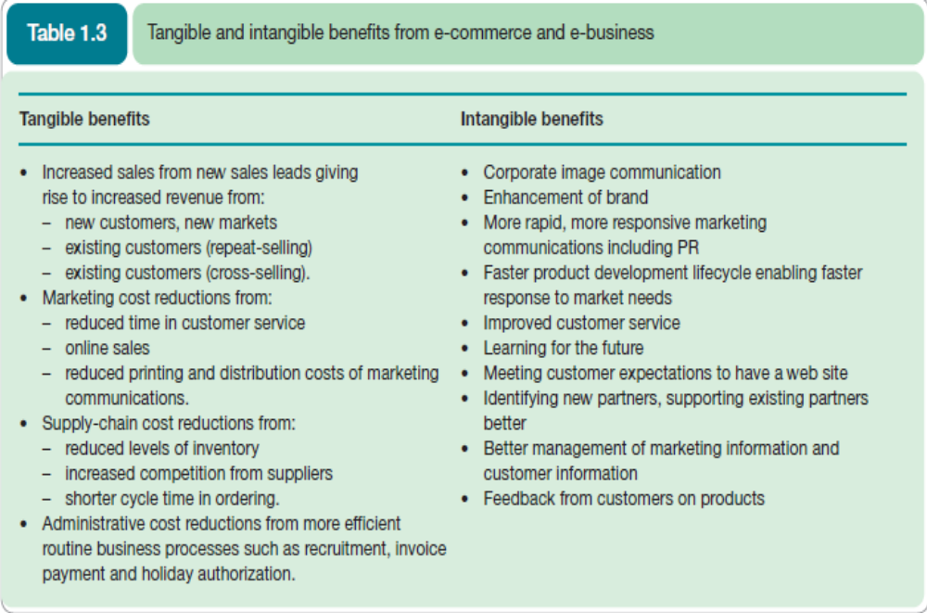
Organised by Dr.Vittapu

Slide 30
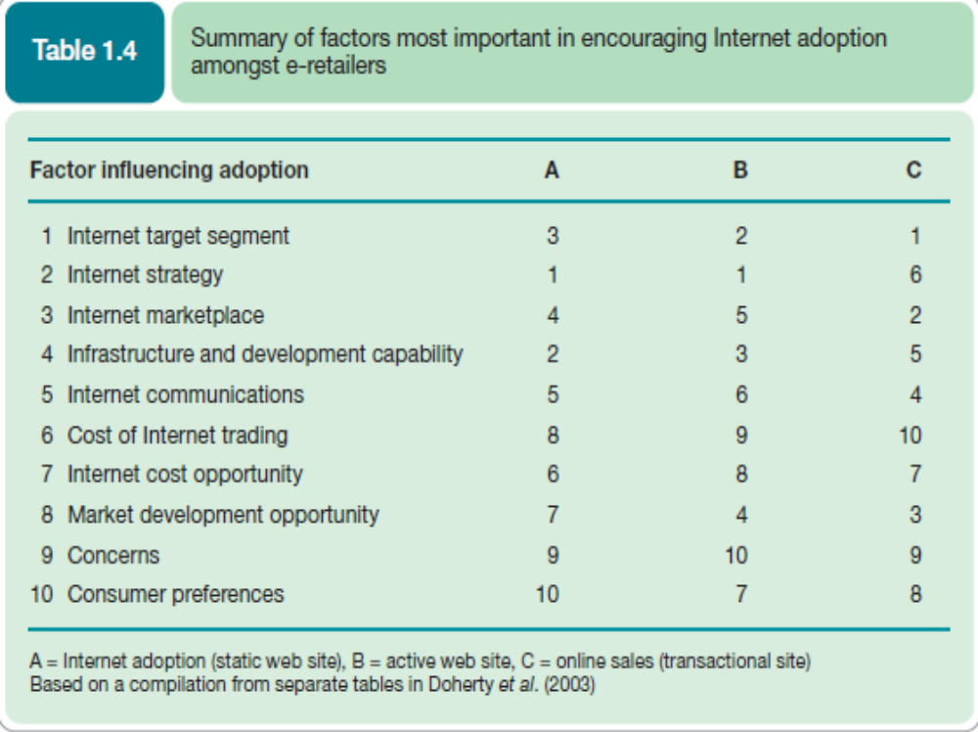
Organised by Dr.Vittapu

Slide 31
E-business risks and barriers to business adoption
Opportunities have to be balanced against the risks of introducing e-business services which vary from strategic risks to practical risks.
One of the main strategic risks is making the wrong decision about e-business investments.
In every business sector, some companies have taken advantage of e-business and gained a competitive advantage.
But others have invested in e-business without achieving the hoped-for returns, either because the execution of the plan was flawed, or simply because the planned approaches used for their market were inappropriate.
The impact of the Internet and technology varies by industry.
The Internet is a typhoon force, a ten times force, or is it a bit of wind? Or is it a force that fundamentally alters our business?
As well as the strategic risks, there are also many practical risks to manage which, if ignored, can lead to bad customer experiences and bad news stories which lead to damage to the reputation of the company.
In the section on e-business opportunities, we reviewed the concept of soft lock-in; however, if the customer experience of a service is very bad, they will stop using it, and switch to other online options.
Organised by Dr.Vittapu

Slide 32
E-business risks and barriers to business adoption
Examples of poor online customer experience which you will certainly be familiar with include:
Web sites that fail because of a spike in visitor traffic after a peak-hour TV advertising campaign.
Hackers penetrating the security of the system and stealing credit card details.
A company e-mails customers without receiving their permission, so annoying customers and potentially breaking privacy and data protection laws.
Problems with fulfilment of goods ordered online, meaning customer orders go missing or are delayed and the customer never returns.
E-mail customer-service enquiries from the web site don’t reach the right person and are ignored.
Organised by Dr.Vittapu

Slide 33
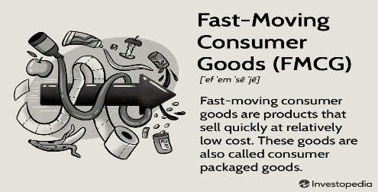
Drivers of consumer Internet adoption
To determine investment in sell-side e-commerce, managers need to assess how to adopt new services such as web, mobile and interactive TV and specific services such as blogs, social networks and feeds.
E-Business companies offering e-commerce services create a clear online value proposition (OVP) to encourage customers to use their specific online services.
Typical benefits of online services are summarized by the ‘Six Cs’, a simple mnemonic to show different types of customer value:
1 Content – In the mid-1990s it was often said that ‘content is king’. Well, relevant rich content is still king. This means more detailed, in-depth information to support the buying process for transactional or relationship-building sites or branded experiences to encourage product usage for FMCG brands. (high consumer demand (e.g., soft drinks and confections) or because they are perishable (Fresh) (e.g., meat, dairy products, and baked goods).
2 Customization – In this case mass customization of content, whether received as web site pages such as ‘Amazon recommends’ or e-mail alerts, and commonly known as ‘personalization’.
3 Community – The Internet liberates consumers to discuss anything they wish through forums, chat-rooms and blog comments.
Organised by Dr.Vittapu

Slide 34
Drivers of consumer Internet adoption
4 Convenience – This is the ability to select, purchase and in some cases use products from your desktop at any time: the classic 24 × 7 × 365 availability of a service.
Online usage of products is, of course, restricted to digital products such as music or other data services.
Amazon has advertised offline using creative showing a Christmas shopper battling against a gale-swept street clutching several bags to reinforce the convenience message.
5 Choice – The web gives a wider choice of products and suppliers than via conventional distribution channels. The success of online intermediaries such as Kelkoo (www.kelkoo.com) and Screen trade (www.screentrade.com) is evidence of this. Similarly, Tesco.com provides Tesco with a platform to give consumers a wider choice of products (financial, travel, white goods) with more detailed information than are physically available in-store.
6 Cost reduction – The Internet is widely perceived as a relatively low-cost place of purchase. Often customers expect to get a good deal online as they realize that online traders have a lower cost-base as they have lower staff and distribution costs than a retailer that runs a network of high-street stores. A simple price differential is a key approach to encouraging usage of online services.
The 7 Cs of Rayport and Jaworski (2003) provide a similar framework of Context, Content, Community, Customization, Communication, Connection and Commerce.
Organised by Dr.Vittapu

Slide 35
Barriers to consumer Internet adoption
An indication of some of the barriers to using the Internet, in particular for consumer purchases, is clear from a survey (Booz Allen Hamilton, 2002) of perceptions in different countries.
It noted that consumer barriers to adoption of the Internet included:
_x0003_ No perceived benefit
_x0003_ Lack of trust
_x0003_ Security problems
_x0003_ Lack of skills
_x0003_ Cost.
This lack of demand for Internet services from this group needs to be taken into account when forecasting future demand.
How should an e-business strategy be developed?
To what extent can we use existing business and IS strategy models?
What are the main changes that need to be made to the organization as part of implementing the strategy?
Organised by Dr.Vittapu

Slide 36
Management responses to e-commerce and e-business
The management issues when businesses look to take advantage of the opportunities afforded by e-commerce and e-business.
How should an e-business strategy be developed?
To what extent can we use existing business and IS strategy models?
What are the main changes that need to be made to the organization as part of implementing the strategy?
Organised by Dr.Vittapu

Slide 37

BIS-MIS 611 Chapter 2 Srisai College Dr.Vittapu

